Slide 1

Chapter 7:
Project Cost Management
Information Technology Project Management, Seventh Edition
Note: See the text itself for full citations.

Slide 2
Learning Objectives
Understand the importance of project cost management
Explain basic project cost management principles, concepts, and terms
Describe the process of planning cost management
Discuss different types of cost estimates and methods for preparing them

Slide 3
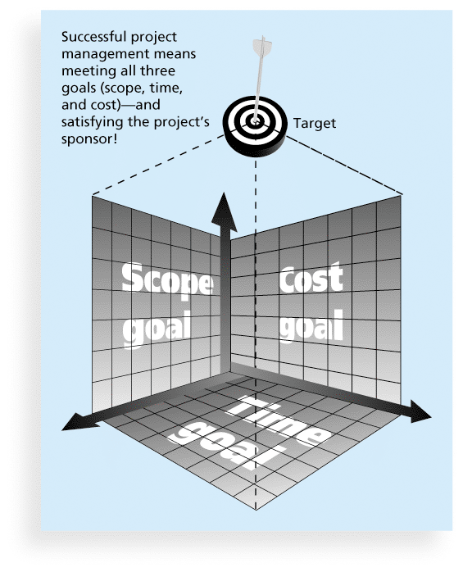
What Is a Project?
A project is “a temporary endeavor undertaken to create a unique product, service, or result” (PMBOK® Guide, 5th Edition, 2012)
Project management is “the application of knowledge, skills, tools and techniques to project activities to meet project requirements” (PMBOK® Guide, 5th Edition, 2012)
Triple Constraint of Project Management

Slide 4
The Importance of Project Cost Management
IT projects have a poor track record for meeting budget goals
The CHAOS studies found the average cost overrun (the additional percentage or dollar amount by which actual costs exceed estimates) ranged from 180 percent in 1994 to 43 percent in 2010
A 2011 Harvard Business Review study reported an average cost overrun of 27 percent. The most important finding was the discovery of a large number of gigantic overages or “black swans”

Slide 5
What is Cost and Project Cost Management?
Cost is a resource sacrificed or foregone to achieve a specific objective or something given up in exchange
Costs are usually measured in monetary units like dollars
Project cost management includes the processes required to ensure that the project is completed within an approved budget

Slide 6
Project Cost Management Processes
Planning cost management :determining the policies, procedures, and documentation that will be used for planning, executing, and controlling project cost.
Estimating costs: developing an approximation or estimate of the costs of the resources needed to complete a project
Determining the budget: allocating the overall cost estimate to individual work items to establish a baseline for measuring performance
Controlling costs: controlling changes to the project budget

Slide 7
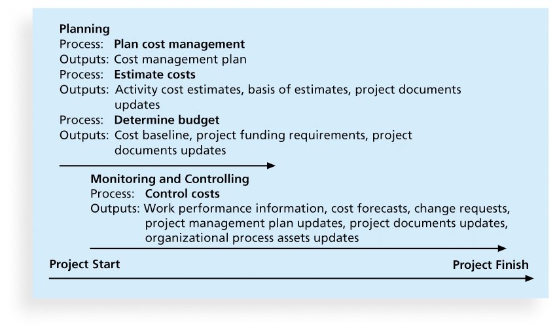
Figure 7-1. Project Cost Management Summary

Slide 8
Basic Principles of Cost Management
Most members of an executive board better understand and are more interested in financial terms than IT terms , so IT project managers must speak their language
  Profits are revenues minus expenditures
  Profit margin is the ratio of revenues to profits
  Life cycle costing considers the total cost of ownership, or development plus support costs, for a project
  Cash flow analysis determines the estimated annual costs and benefits for a project and the resulting annual cash flow

Slide 9
Types of Costs and Benefits
Tangible costs or benefits are those costs or benefits that an organization can easily measure in dollars
Intangible costs or benefits are costs or benefits that are difficult to measure in monetary terms
Direct costs are costs that can be directly related to producing the products and services of the project
Indirect costs are costs that are not directly related to the products or services of the project, but are indirectly related to performing the project

Slide 10
More Basic Principles of Cost Management
Learning curve theory states that when many items are produced repetitively, the unit cost of those items decreases in a regular pattern as more units are produced
Reserves are dollars included in a cost estimate to mitigate cost risk by allowing for future situations that are difficult to predict
  Contingency reserves allow for future situations that may be partially planned for (sometimes called known unknowns) and are included in the project cost baseline
  Management reserves allow for future situations that are unpredictable (sometimes called unknown unknowns

Slide 11
Planning Cost Management
The project team uses expert judgment, analytical techniques, and meetings to develop the cost management plan
A cost management plan includes:
  Level of accuracy and units of measure
  Organizational procedure links
  Control thresholds
  Rules of performance measurement
  Reporting formats
  Process descriptions

Slide 12
Estimating Costs
Project managers must take cost estimates seriously if they want to complete projects within budget constraints
It’s important to know the types of cost estimates, how to prepare cost estimates, and typical problems associated with IT cost estimates

Slide 13
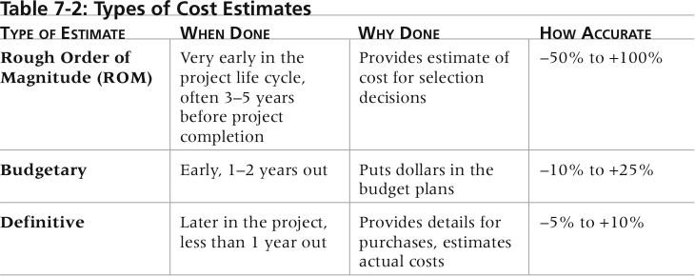
Table 7-2. Types of Cost Estimates

Slide 14
More on Cost Estimates
The number and type of cost estimates vary by application area. The Association for the Advancement of Cost Engineering International identifies five types of cost estimates for construction projects: order of magnitude, conceptual, preliminary, definitive, and control
Estimates are usually done at various stages of a project and should become more accurate as time progresses
A large percentage of total project costs are often labor costs

Slide 15
Cost Estimation Tools and Techniques
Basic tools and techniques for cost estimates:
  Analogous or top-down estimates: use the actual cost of a previous, similar project as the basis for estimating the cost of the current project
  Bottom-up estimates: involve estimating individual work items or activities and summing them to get a project total
  Parametric modeling uses project characteristics (parameters) in a mathematical model to estimate project costs

Slide 16
Typical Problems with IT Cost Estimates
Estimates are done too quickly
People lack estimating experience
Human beings are biased toward underestimation
Management desires accuracy

Slide 17
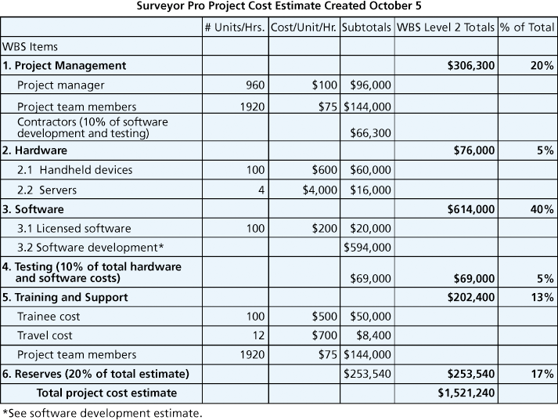
Figure 7-2. Surveyor Pro Project Cost Estimate

Slide 18
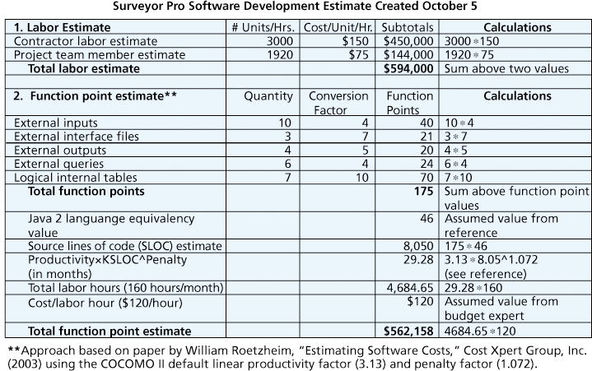
Figure 7-3. Surveyor Pro Software Development Estimate

Slide 19
Determining the Budget
Cost budgeting involves allocating the project cost estimate to individual work items over time
The WBS is a required input to the cost budgeting process since it defines the work items
Important goal is to produce a cost baseline
  a time-phased budget that project managers use to measure and monitor cost performance

Slide 20
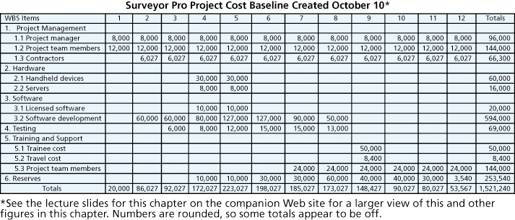
Figure 7-4. Surveyor Pro Project Cost Baseline

Slide 21
Controlling Costs
Project cost control includes
  Monitoring cost performance
  Ensuring that only appropriate project changes are included in a revised cost baseline
  Informing project stakeholders of authorized changes to the project that will affect costs
Many organizations around the globe have problems with cost control

Slide 22
Earned Value Management (EVM)
EVM is a project performance measurement technique that integrates scope, time, and cost data
Given a baseline (original plan plus approved changes), you can determine how well the project is meeting its goals
You must enter actual information periodically to use EVM
More and more organizations around the world are using EVM to help control project costs

Slide 23
Earned Value Management Terms
The planned value (PV), formerly called the budgeted cost of work scheduled (BCWS), also called the budget, is that portion of the approved total cost estimate planned to be spent on an activity during a given period
Actual cost (AC), formerly called actual cost of work performed (ACWP), is the total of direct and indirect costs incurred in accomplishing work on an activity during a given period
The earned value (EV), formerly called the budgeted cost of work performed (BCWP), is an estimate of the value of the physical work actually completed
EV is based on the original planned costs for the project or activity and the rate at which the team is completing work on the project or activity to date

Slide 24
Rate of Performance
Rate of performance (RP) is the ratio of actual work completed to the percentage of work planned to have been completed at any given time during the life of the project or activity
For example, suppose the server installation was halfway completed by the end of week 1. The rate of performance would be 50% because by the end of week 1, the planned schedule reflects that the task should be 100 percent complete and only 50 percent of that work has been completed

Slide 25
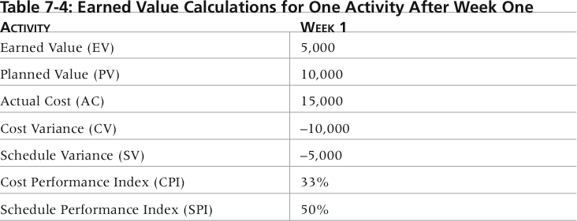
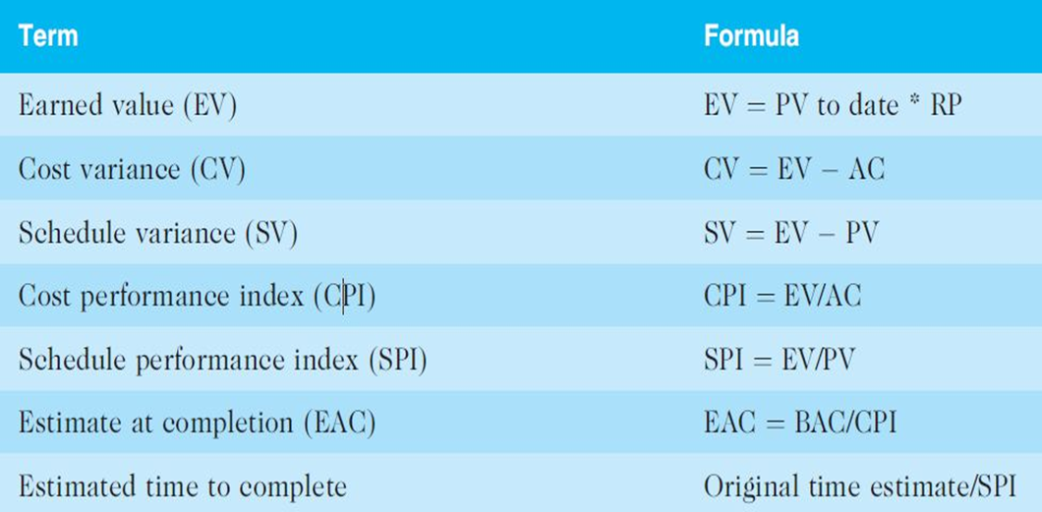
Table 7-4. Earned Value Calculations for One Activity After Week One

Slide 26
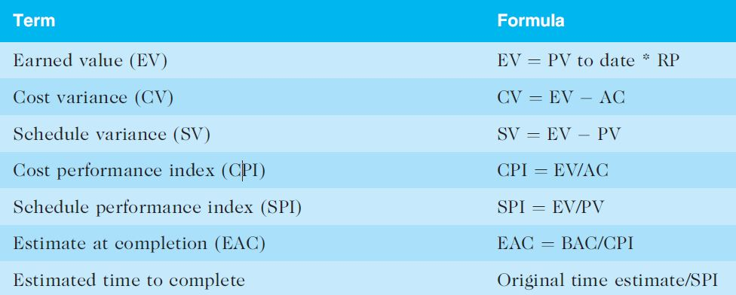
Table 7-5. Earned Value Formulas

Slide 27
Rules of Thumb for Earned Value Numbers
Negative numbers for cost and schedule variance indicate problems in those areas
CPI and SPI less than 100% indicate problems
Problems mean the project is costing more than planned (over budget) or taking longer than planned (behind schedule)
The CPI can be used to calculate the estimate at completion (EAC)—an estimate of what it will cost to complete the project based on performance to date. The budget at completion (BAC) is the original total budget for the project

Slide 28
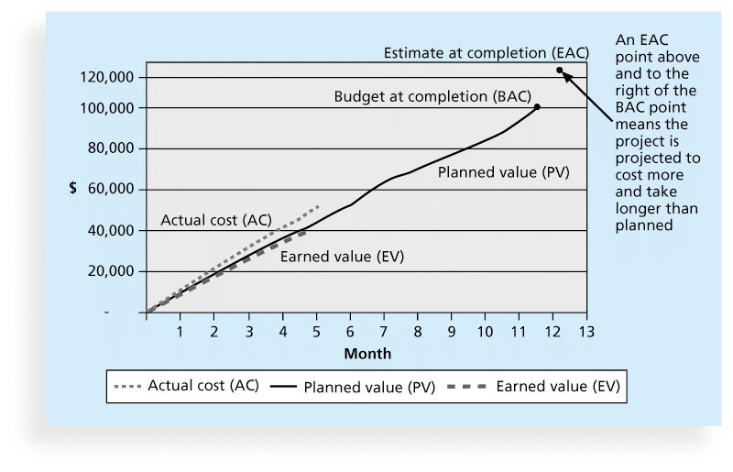
Figure 7-5. Earned Value Chart for Project after Five Months

Slide 29
Using Software to Assist in Cost Management
Spreadsheets are a common tool for resource planning, cost estimating, cost budgeting, and cost control
Many companies use more sophisticated and centralized financial applications software for cost information
Project management software has many cost-related features, especially enterprise PM software
Portfolio management software can help reduce costs

Slide 30
Chapter Summary
Project cost management is a traditionally weak area of IT projects, and project managers must work to improve their ability to deliver projects within approved budgets
Main processes include
  Plan cost management
  Estimate costs
  Determine the budget
  Control costs

